Slide 1


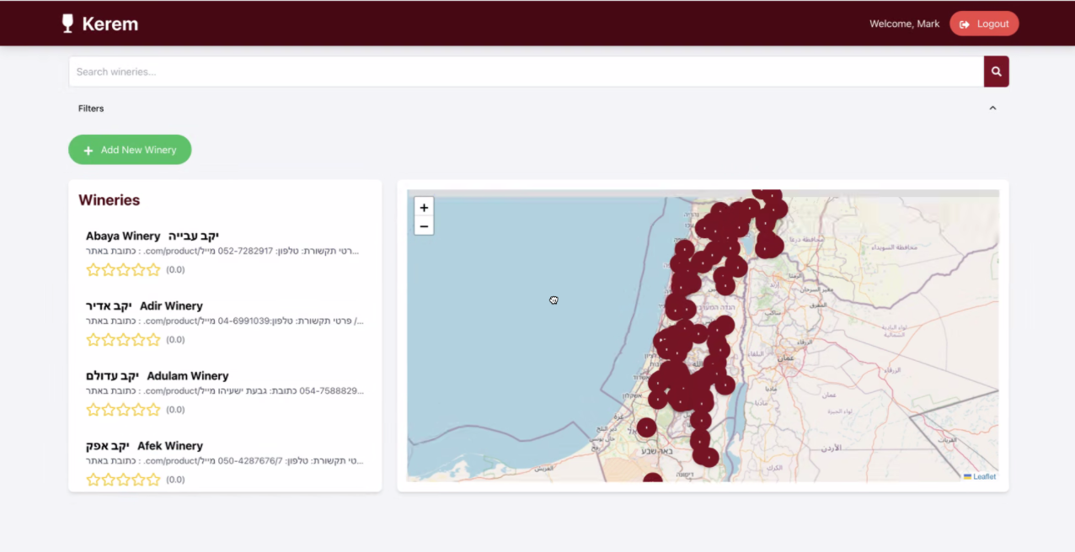
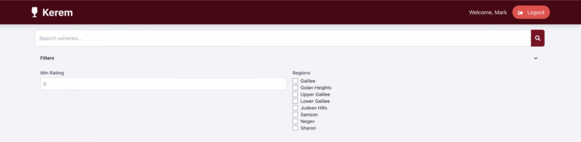
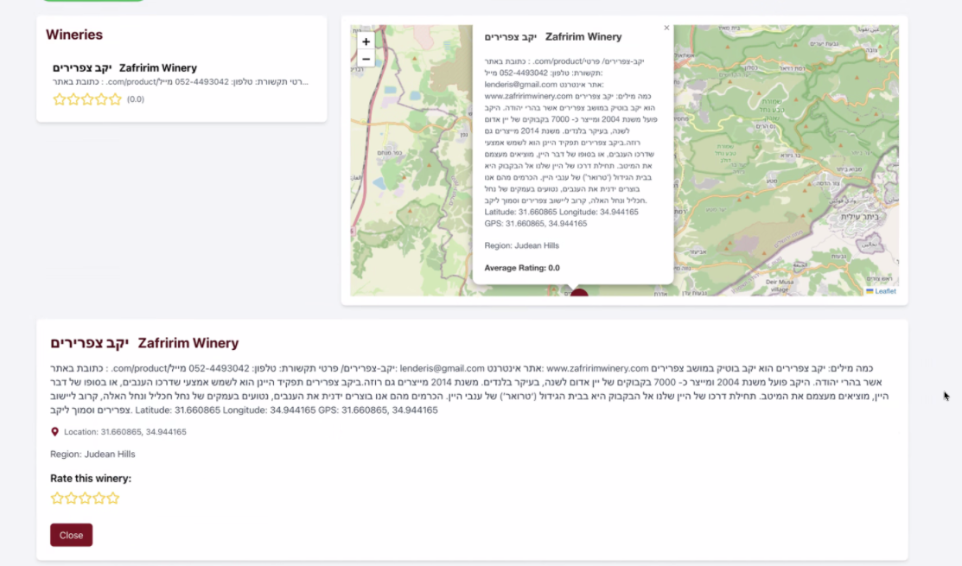





Kerem GIS-Based System for Wineries in Israel
Instructor – Mark Israel
Submitted By: Ido Dohan, Shahar Tevelov, Lihi Shemesh, Shilat Dror and Tav Oskar
Department of Computer Science, Faculty of Science, Spring Semester 2024
Project Essence
Project Contribution to Creators
Background:
In recent decades, the wine industry has developed significantly, both in the growing number of wineries in the country and in the demand for visiting wineries.
The geographical dispersion of wineries, along with the differences between them, makes it difficult to locate a nearby or recommended winery.
Project Objective:
Development of a WEB application based on a geographic component for mapping and documenting wineries in Israel. It allows users to locate various wineries in Israel based on different parameters, obtain information about them, and share reviews.
Introduction to the field of GIS and acquisition of tools for development in this area.
Opportunity to develop and deepen our project management skills.
The project taught us how to integrate geographical tools into information systems.
Familiarity with new tools and programming languages such as: postGIS and PostgreSQL.
Creativity, collaboration, and teamwork.
Screenshots
Schemes
Search bar for wineries
Map with the winery's location
The applications functions
Use-case
Search Wineries
Login
Login
Registration
Authentication
Authentication
Display Wineries Map
Search winery by rate
Search winery by name
Search and Filter Wineries
Rating Wineries
Search By
Display Wineries on Map
Add Winery
Search winery by region
Area
Name
Rating
Display Results Map and List
Information about a winery
Technologies
Winery rating
Instructional Video
https://youtu.be/-P0GHOm9Ngs

